Slide 1
ASSIGNMENT
6
SHINORIA

Slide 2
CONTENT
Artificial intelligence
Machine learning
Types of learning by ML
Regression & Classification

Slide 3
ARTIFICIAL INTELLIGENCE
Artificial Intelligence (AI) is a broad field of computer science that aims to create intelligent machines capable of mimicking human cognitive abilities. It involves the development of algorithms, models, and systems that can perceive, reason, learn, and make decisions. AI systems can process large amounts of data, recognize patterns, and make predictions or take actions based on the information they gather.In short human intelligence in a computer is A.I.
Branches of AI are :
Machine Learning
Deep Learning
Natural Language Processing
Robotics
Expert Systems
Fuzzy Logic

Slide 4
MACHINE LEARNING
Machine Learning (ML) is a subset of AI that focuses on the development of algorithms and models that enable computers to learn from data and make predictions or decisions without being explicitly programmed. In ML, instead of writing explicit rules or instructions, the system learns from examples or experiences. It involves training a model on a dataset, and the model then uses that knowledge to make predictions or classify new data.
MACHINE LEARNING ALGORITHMS
ML algorithms can be categorized into different types:
Supervised Learning
Unsupervised Learning
Reinforcement Learning

Slide 5
SUPERVISED LEARNING:
When a input is provided as a labelled dataset, a model can learn from it and this kind of learning is called supervised learning.
Unsupervised Learning:
There is no complete and clean labelled dataset in unsupervised learning.
It is a type of self-organised learning that helps find previously unknown patterns in data sets without pre-existing labels.
Reinforcement learning:
It is about taking suitable action to maximize reward in a particular situation.
It works on basis of a reward and penalty system.

Slide 6
Types of Analytics
Predictive Analytics – Machine Learning comes under Predictive Analysis. Using the past data, we predict the future outcome in Machine Learning.
Prescriptive Analytics
Descriptive Analytics
Diagnostic Analytics

Slide 7
Conventional Programming VS Machine Learning
In conventional programming, we write the program/code which has the equation. We give input to our program and get the output from the program.
In Machine Learning, we give both input and output data to the program, in turn we get the equation/relation between the input and output, which can be used to predict the output in future using the input data provided.

Slide 8
Machine Learning Algorithms
Machine Learning Algorithms are the programs which take the Features and Labels data and give us the relation/equation between the Features and Labels.
There are mainly two types of Machine Learning Algorithms, they are:
Regression Algorithms
Classifier Algorithms
Regression Algorithms are used when the data is continuous, i.e., for continuous-data prediction.
Classifier Algorithms are used to take decisions(based on Boolean Values-True or False, 1 or 0, etc)

Slide 9
Linear Regression Explanation
Regression Algorithm – Linear Regression – Linear Regression is used when the features and labels are linearly related.
Eg: x : 1 2 3 4 5 6
y : 4 7 10 13 16 19
In this example, we see that y is related to x by the equation y=3x+1, indicating the linearity of the relation.
Regression Algorithm can be used for any data where inputs and outputs are related by the function y=mx+c, where power of x always is 1

Slide 10
Algorithms
Regression Algorithm
Classification Algorithm
Linear Regression
Logistic regression
Decision Tree
SVM(Support Vector Machine)
K-nearest neighbor
Naive Bayes system

Slide 11
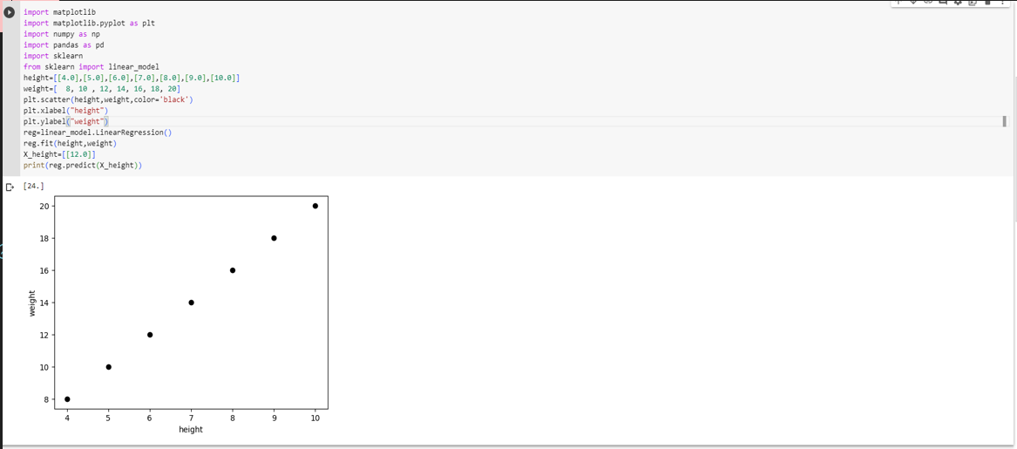
Linear Regression Code

Slide 12
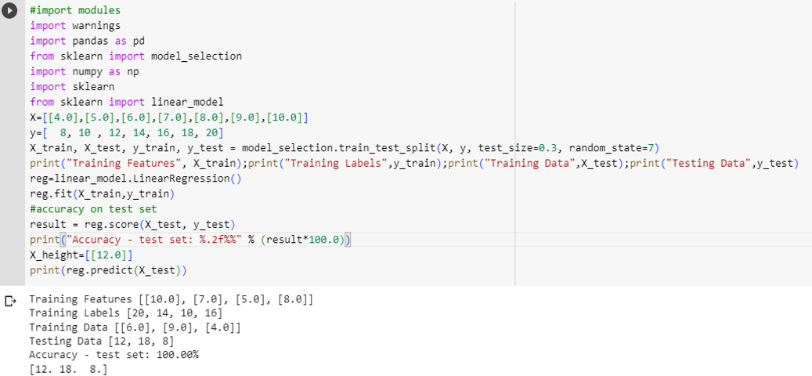
Linear Regression Code

Slide 13
Classification Algorithm
Classification Algorithm – Classification Algorithms are used whenever there is a need to take a decision based on input values.
Eg: Marks : 20 30 35 40 60 80
Pass/Fail : F F P P P P
In this example, we see that the Student will be declared Pass if he scores 35 or above marks, and will be declared Fail if he scores less than 35
Classifier Algorithms can be used whenever there is a need to take a decision based on the input(features) values

Slide 14
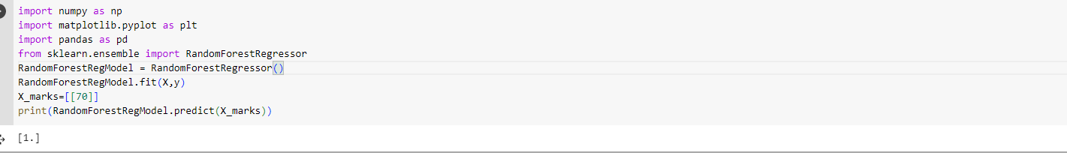
Random Forest Example

Slide 15
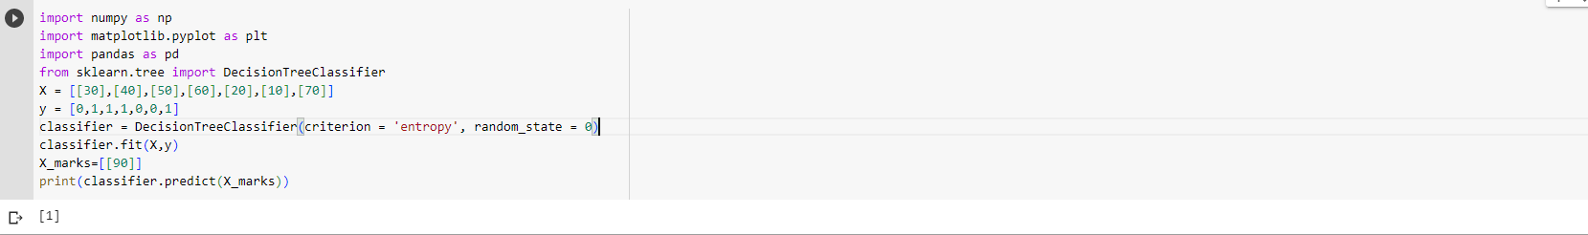
Decision Tree Example

Slide 16
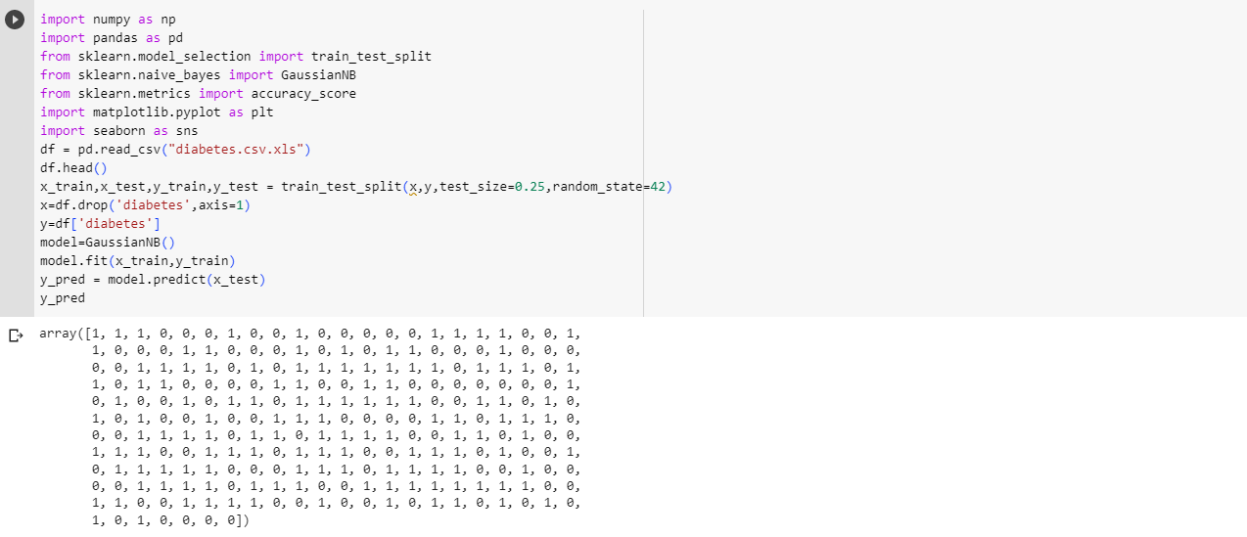
Naive Bayes Example

Slide 17
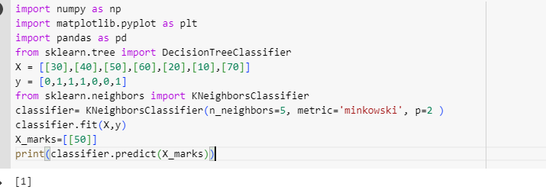
KNN example

Slide 18
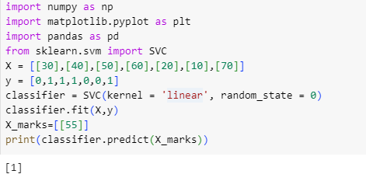
SVM example

